Slide 1
SMART SOLUTION FOR RAILWAYS
DOMAIN NAME: INTERNET OF THINGS
TEAM ID : PNT2022TMID38188
TEAM MEMBERS:
TEAM LEADER : DEVIBALA V
TEAM MEMBER 1: SHARMILA B
TEAM MEMBER 2: HEMA S
TEAM MEMBER 3: SANTHALAKSHMI L
TEAM MEMBER 4: KEERTHIMATHI M

Slide 2
AGENDA
Introduction
Purpose
Problem Statement
Technical Architecture
Process
Future scope

Slide 3
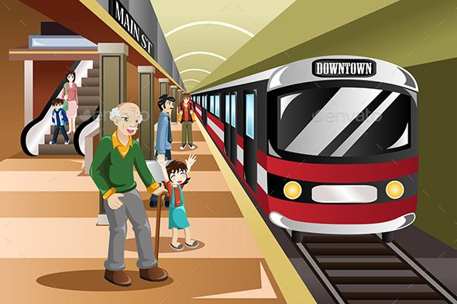
Introduction
The developed countries has been implemented smart train using internet of things(IOT)
IOT based on the system. Using IDL python program . IOT can improve the efficiency of rail travel, and customer experience all those who use it. Smart sensor can used to track important assets, manager passenger flow, and enable predictive maintenance.
Smart solution of railways is designed to reduce the work load of user.
In the given project we will developing a web page with help of user find train detail and GPS module present in the train to track it.

Slide 4
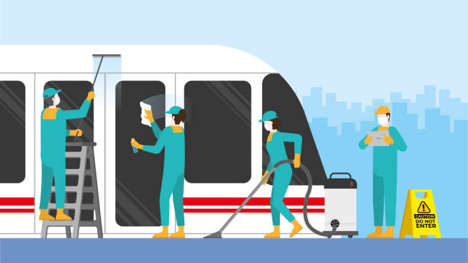
purpose
A web page is designed for the public where can book Tickets by sending the available seats.
Ticket booking system by using QR code scanning. A GPS module is present in the train to track it. The live status of the journey is update in the web app continuously.

Slide 5
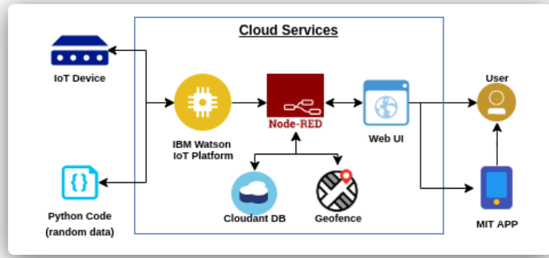
Cloud services

Slide 6
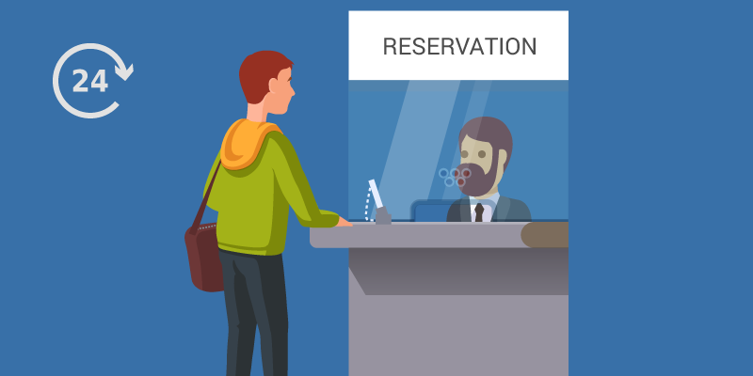
Performance metrics
The user will find the available of the seat.
Tickets booking system by QR code scanning. A GPS module is present in the train to track. The live status of the journey is updated in the web app continuously. The ticket collectors can scan the QR code to identify the personal details.
Easy to use.

Slide 7
Code and solution
QR code
import cv2 as cv import numpy as np import time
import pyzbar.pyzbar as pyzbar
from ibmcloudant.cloudant_v1 import CloudantV1
from ibmcloudant import CouchDbSessionAuthenticator
from ibm_cloud_sdk_core.authenticators import BasicAuthenticator import wiotp.sdk.device
authenticator=BasicAuthenticator('apikey-v2- 2ji0x00sov1b6clf61hctelp07os2c41mauy6mk7a3ot', '6866a033c311b4968d996ca9fa217206')
service=CloudantV1(authenticator=authenticator) service.set_service_url('https://apikey-v2- 2ji0x00sov1b6clf61hctelp07os2c41mauy6mk7a3ot:6866a033c311b4968d996ca9fa 217206@53e4077b-d008-4545-8ea1-1d70926b1b71-
bluemix.cloudantnosqldb.appdomain.cloud')
cap = cv.VideoCapture(0) font = cv.FONT_HERSHEY_PLAIN if not cap.isOpened():
print("Cannot open camera") exit()
myConfig = {
"identity" :{
"orgId":"u3neop",
"typeId":"qrcode", "deviceId":"1234567"
},
"auth":{
"token":"1234567890"
}
}
def myCommandCallback(cmd):
print("Message received fromIBM IoT Platform: %s" % cmd.data['command'])
m=cmd.data['command']

Slide 8
client = wiotp.sdk.device.DeviceClient(config=myConfig, logHandlers=None)
client.connect()
def pub(data):
client.publishEvent(eventId = "status", msgFormat="json", data=response, qos=0, onPublish=None)
print("Published data Successfully: %s",response) print("\n")
while True:
ret, frame=cap.read()
decodedObjects = pyzbar.decode(frame) if not ret:
print("Can't receive frame (stream end?). Exiting ...") break
for obj in decodedObjects: a=obj.data.decode('UTF-8') cv.putText(frame, "Ticket", (50,50),font,2,
(255 ,0, 0),3)
try:
response=service.get_document( db='bookingdetails', doc_id = a
) .get_result() print(response) print("\n\n") pub(response) time.sleep(5)
except Exception as e: response={'Error':'Not a Valid Ticket'} pub(response)
print("Not a Valid Ticket") print("\n\n")
time.sleep(5)

Slide 9
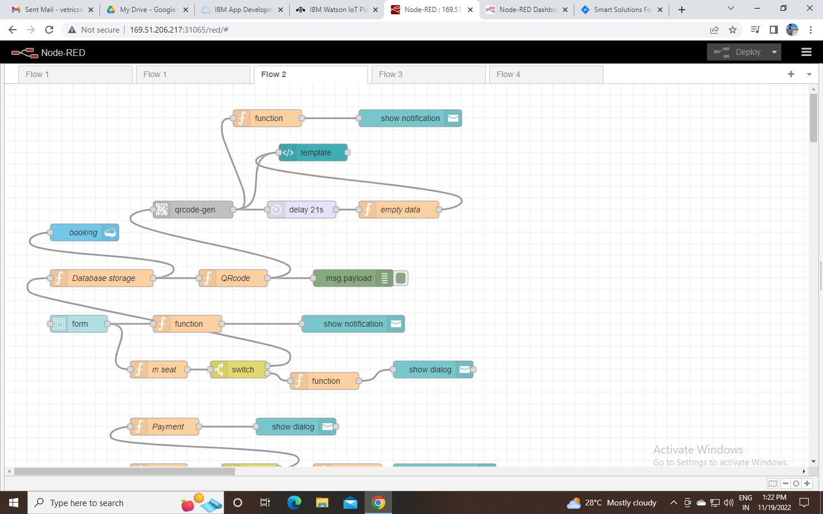
cv.imshow("Frame" ,frame)
if cv.waitKey(1) & 0xFF == ord('q'): break
client.commandCallback = myCommandCallback cap.release()
cv.destroyAllWindows() client.disconnect()

Slide 10
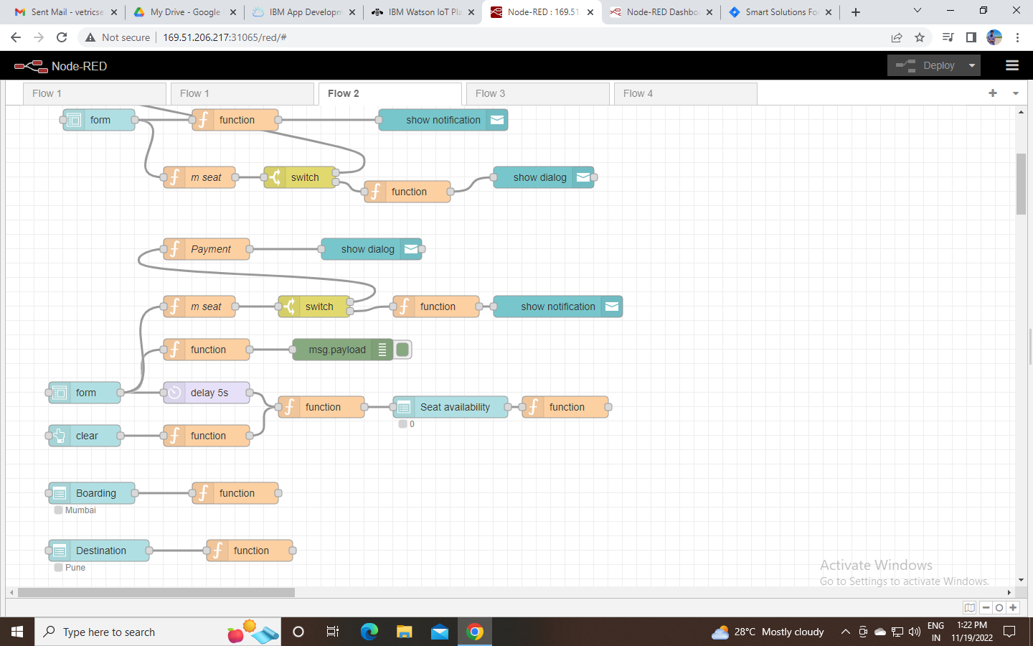

Slide 11
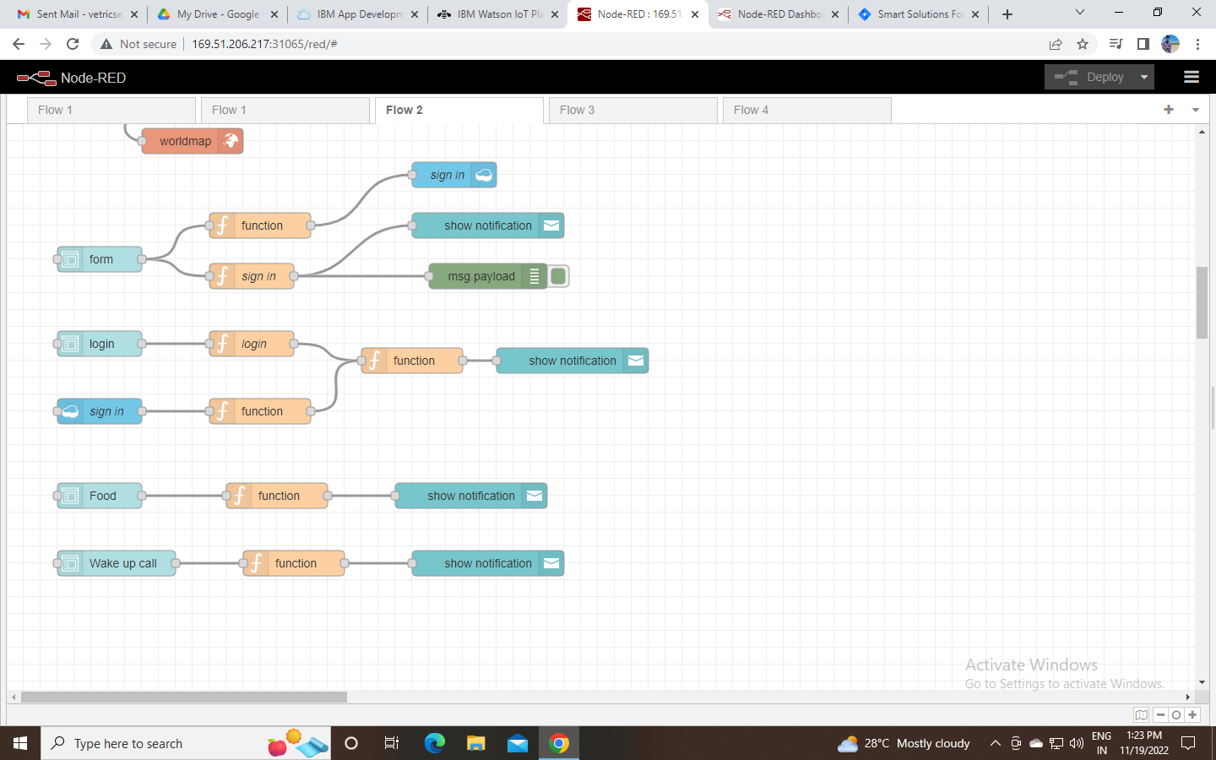

Slide 12
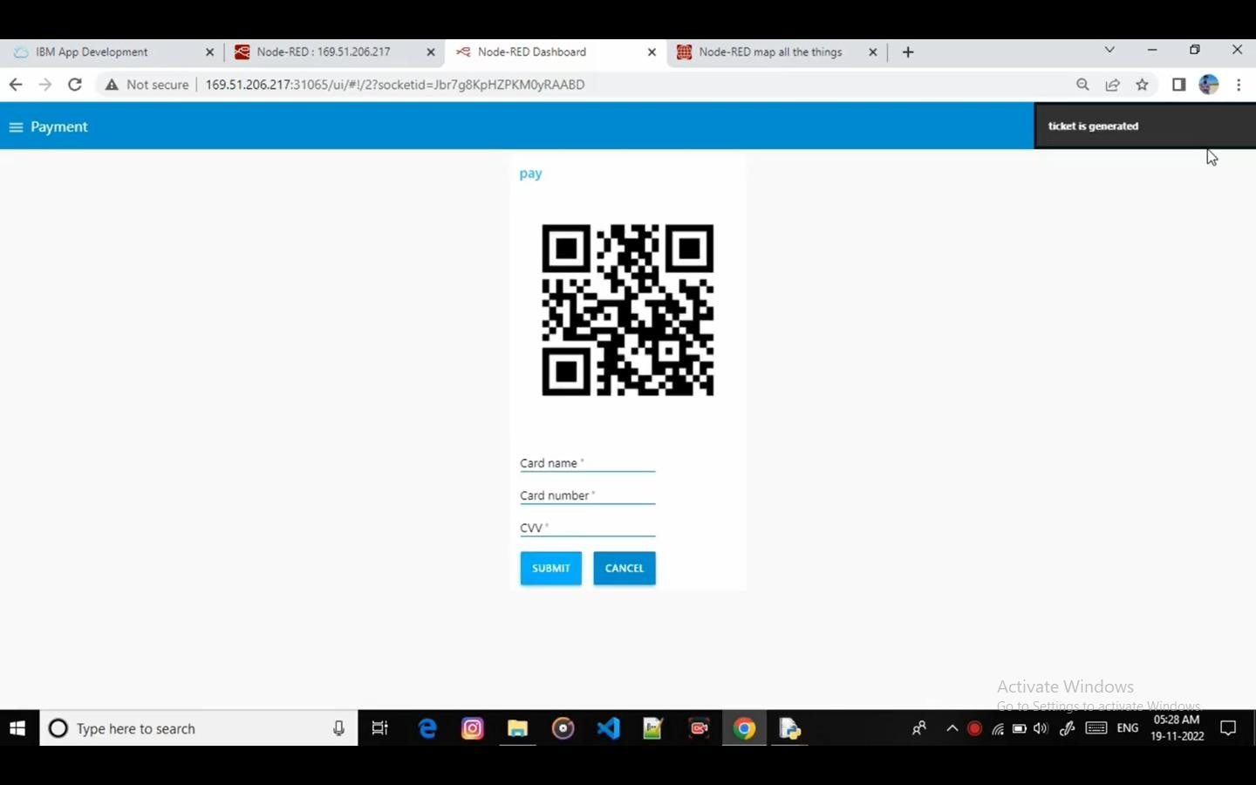

Slide 13
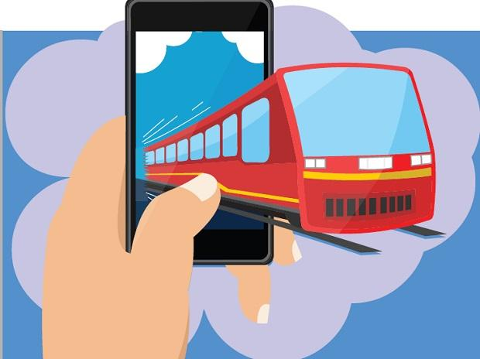
Future scope
Innovation for superior passenger experience increase safety and security for passenger, staff and assets. Improve operational efficiency.

Slide 14
thank you
To All

